Slide 1
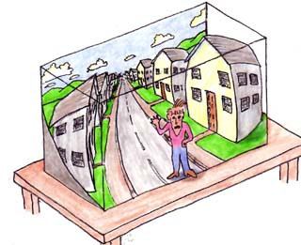

The Dimensions of Visual Experience
A quantitative analysis
Steven Lehar
Notes:
What are the dimensions of visual experience? Is it possible to express the content of conscious experience in quantitative terms?

Slide 2
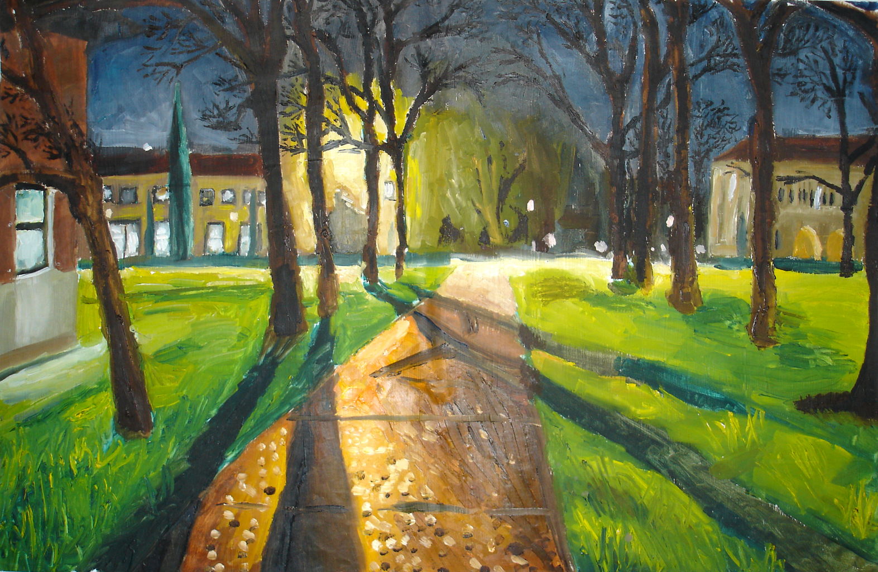

Slide 3


Slide 4
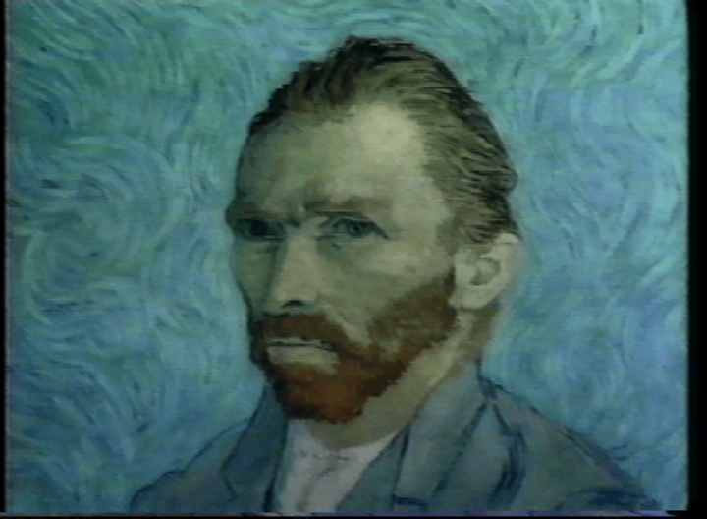

Slide 5
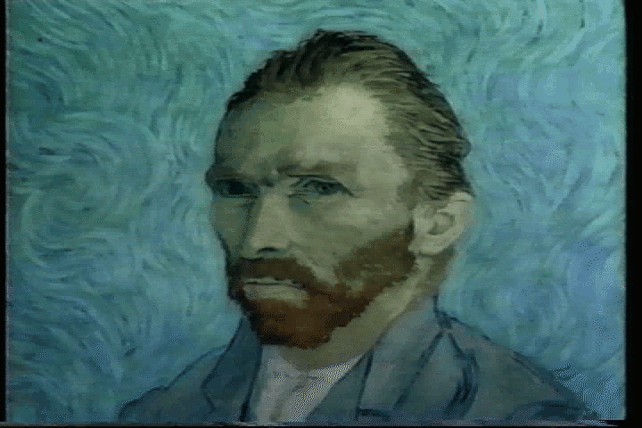

Slide 6
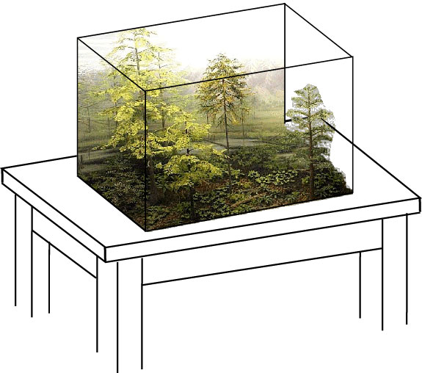

Slide 7


Slide 8
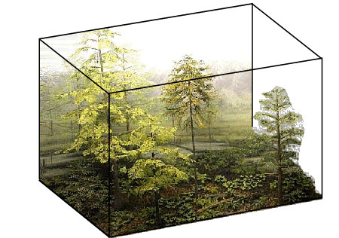
Visual experience is spatially structured

Slide 9


Slide 10
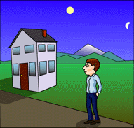
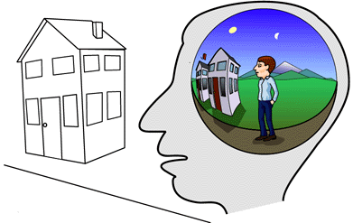
The Epistemological Divide
Direct Perception
Naïve Realism
Indirect Perception
Representationalism
The world we see around us
is the world itself
The world we see around us
is not the real world, but
A perceptual replica of that world

Slide 11
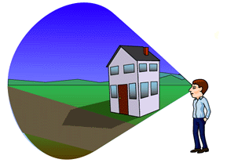
The Epistemological Divide
Projection Theory
Experience is a spatial structure produced by the brain,
projected back out of the brain to appear superimposed on the world

Slide 12
The Epistemological Divide
Direct Perception
Representationalism
Projection Theory
The issue remains unresolved
One of these paradigms must be right
The issue is not inconsequential
Determines what visual processing DOES

Slide 13
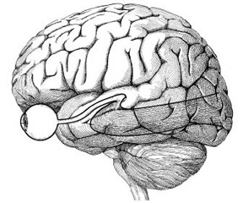
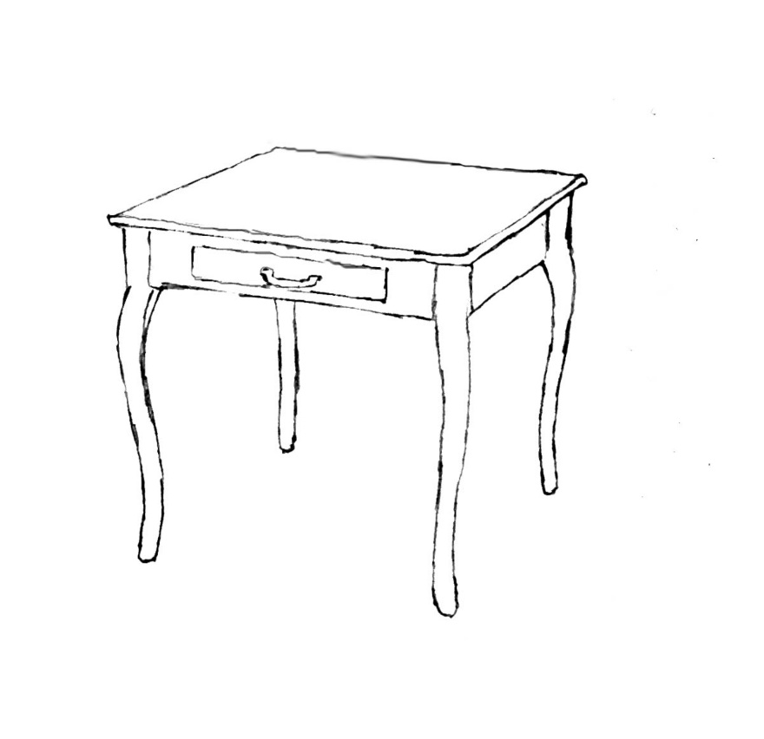
The Causal Chain of Vision
light

Slide 14
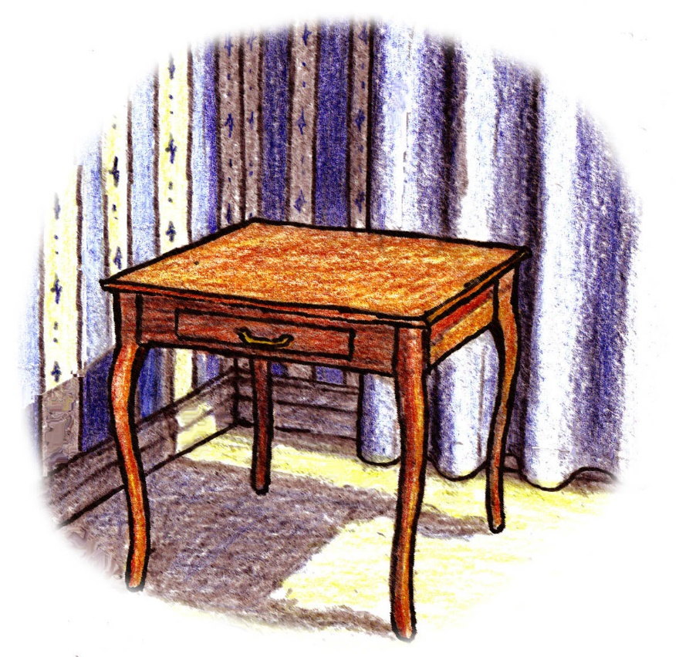
Direct Perception

Slide 15
Direct Perception
The experience itself is not spatially extended
Only the world that it is an experience of
Spatial structure at both ends of causal chain

Slide 16
Direct Perception
Is the structure seen in experience
part objective world, part subjective experience?
How to distinguish objective from subjective?

Slide 17
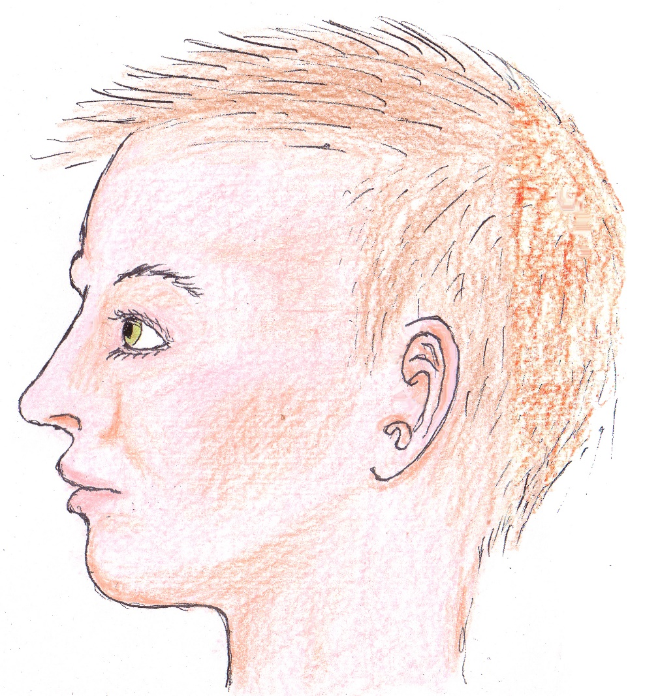
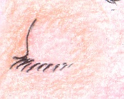
Direct Perception
The fact that it vanishes shows that
it comes at the end of the causal chain

Slide 18
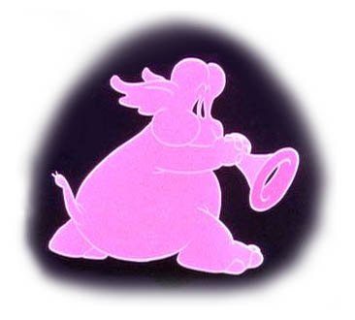
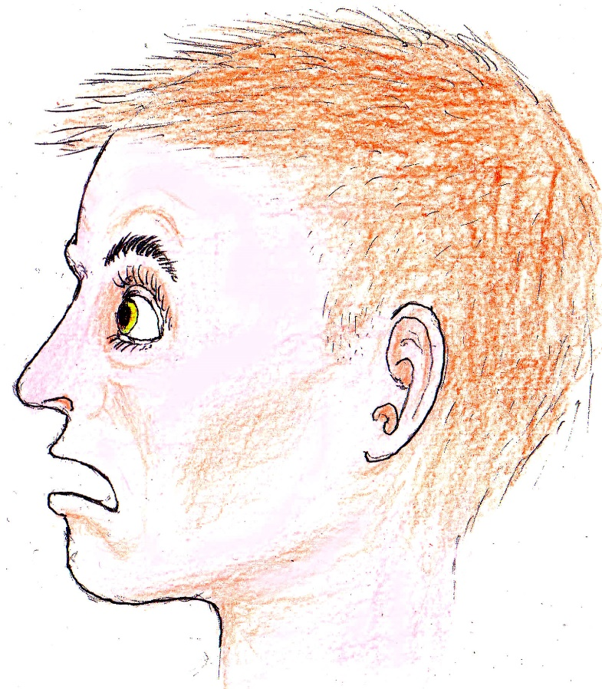
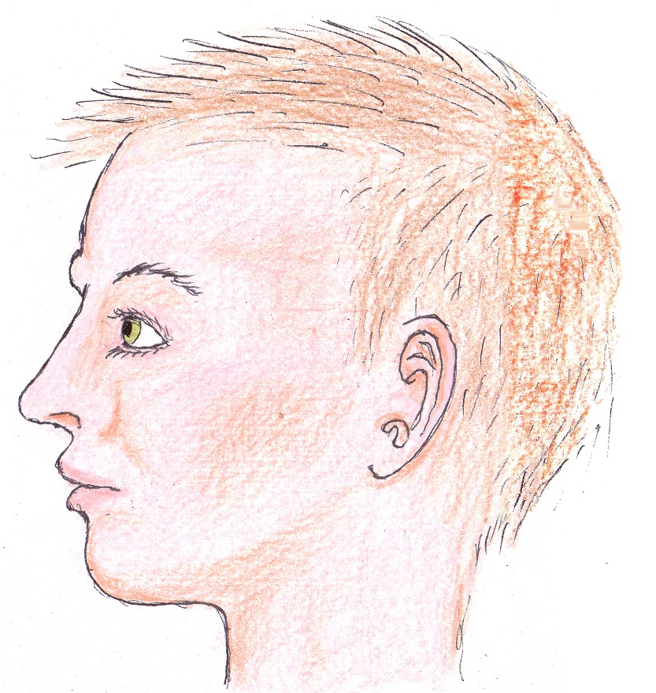
Dreams and Hallucinations
Direct Perception fails catastrophically

Slide 19
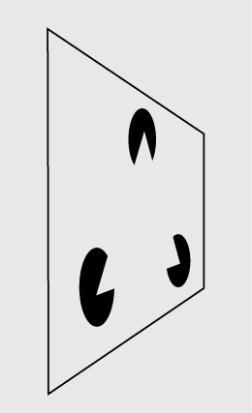
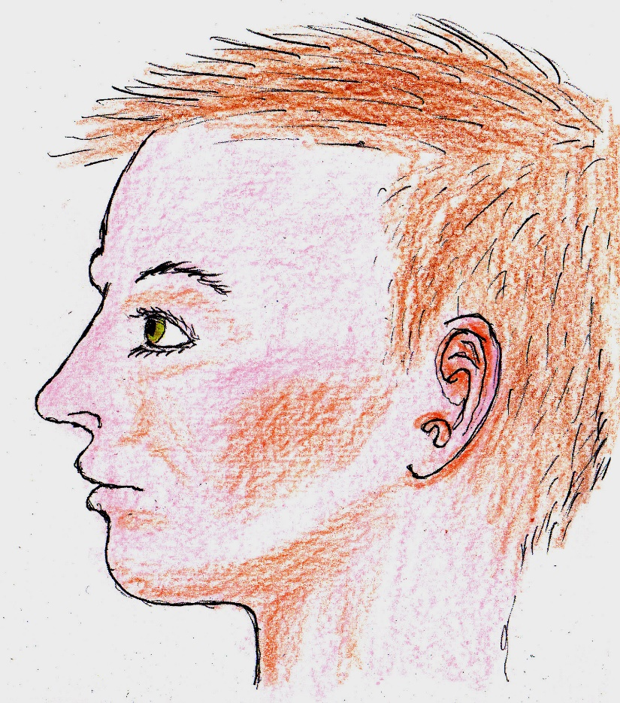
Visual Illusions
Direct Perception fails catastrophically

Slide 20
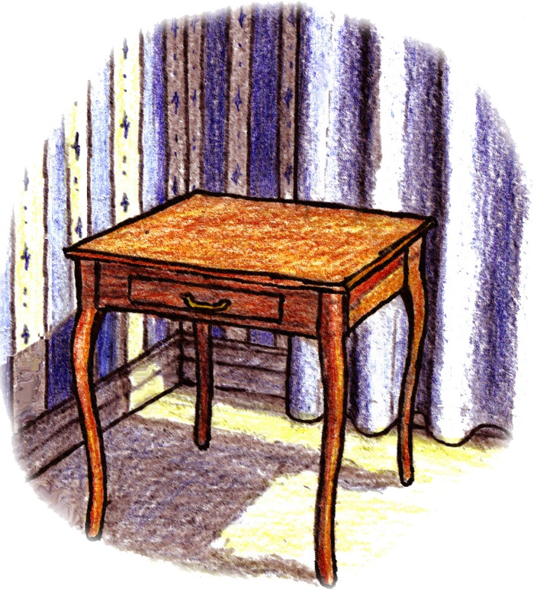
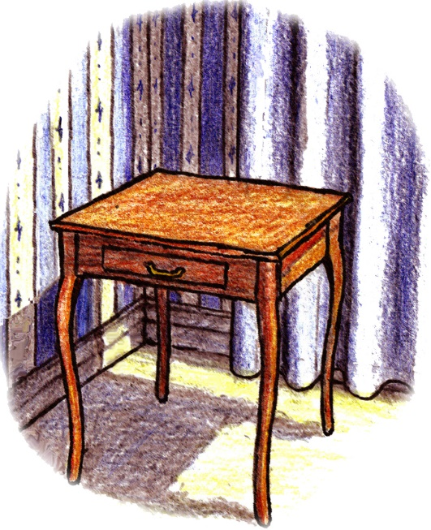
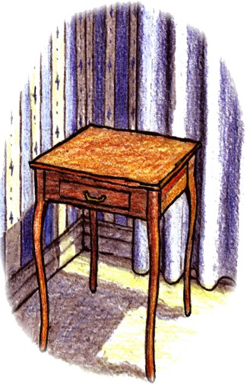

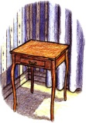
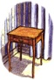
Projection Theory

Slide 21
Projection Theory
Nothing physical detected projecting out of the brain
Velmans (1990): Nothing physical is projected
Projected entity inaccessible to scientific scrutiny
Theory cannot be falsified
Banishes the most interesting part of the problem

Slide 22
Eliminative Materialism
Quine (1961)
Rorty (1965)
Dennett (1987)
Experience is an illusion
We cannot trust our experience to be as it appears

Slide 23
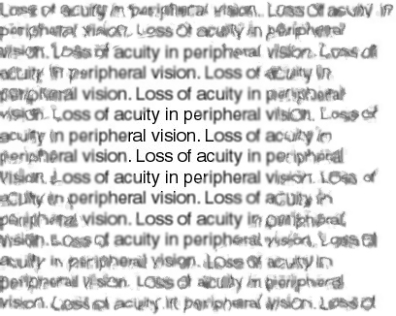
Unreliability of Introspection
Fixation point

Slide 24






Blind Spot
Fixation point

Slide 25
Reliability of Introspection
Fixation point

Slide 26
Blind Spot
Fixation point

Slide 27
Introspection not unreliable in and of itself
Only casual introspection by naïve observers
Critical introspection by informed observers

Slide 28


Slide 29

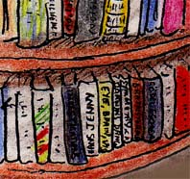
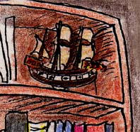
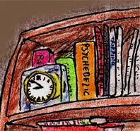


Slide 30

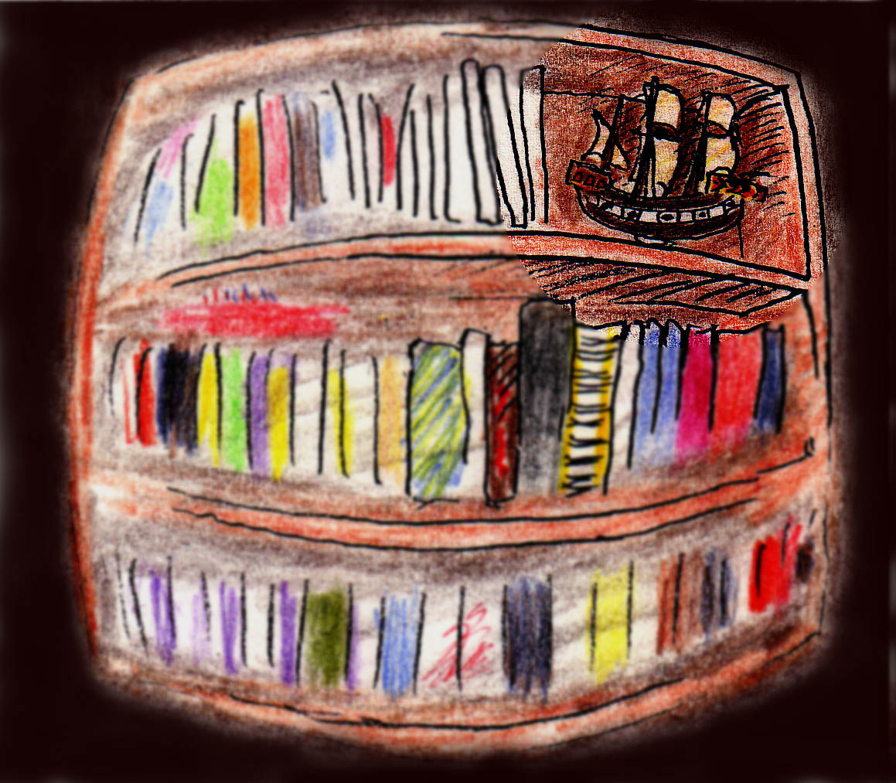


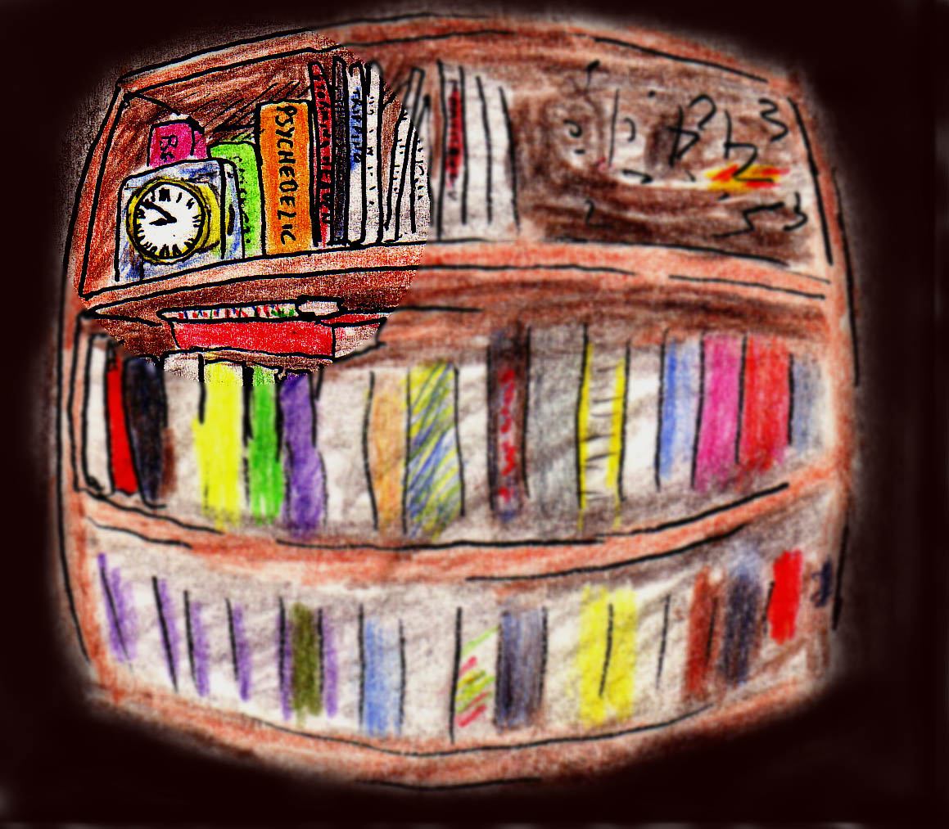

Slide 31
Inescapable Conclusion
Visual experience is spatially structured
To deny the spatial aspect of experience
The eliminative hypothesis turns epistemology ON ITS HEAD!

Slide 32
Even when experience is illusory
To claim that experience is different than it is experienced is a contradiction in terms!

Slide 33
There exists a spatial structure that appears at the end of the causal chain, and it is that spatial structure that I propose to model.
Representationalist: Model of the sense-data of experience;
A direct computational product of the brain based on sensory input
Direct Perception: Model of the objects and surfaces that would be perceived directly, out in the world, for a given sensory input
Projection Theorist: Model of the experience that is experienced to be projected out into the world
Eliminative Materialist: Model of the experience that does not exist, is not even experienced to exist, but only seems to be experienced to exist

Slide 34
Modeling Visual Experience
Once we acknowledge the existence of the spatial structure of experience, how can we model that experience in quantitative terms?
Diorama with explicit volumes and colored surfaces
Volumetric (voxel) model as used in medical MRI and CAT scan imagery
There are many alternative ways to represent spatial information
Important distinction between abstraction and reification

Slide 35
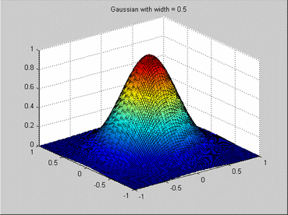
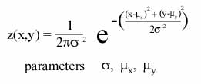
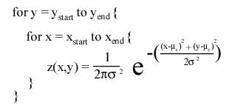
Abstraction v.s. Reification
Abstraction
Reification
The equation is a compressed form
Not to be confused with the shape itself
To create the pattern you have to reify the formula
Array z[x,y]

Slide 36


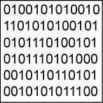
Information Theory
Image compression
Image DEcompression
Compressed image
Abstracted
Low Redundancy
Spatial image
Reified
High Redundancy
Compressed code is useless without decompression algorithm
The information saved in compression is implicit in the decompression algorithm

Slide 37
Semantic Network
contains
composed of
corner
wall
wall
floor
baseboard
pattern
table
color
curtain
color
Stripes
yellow
Vertical
walnut
blue
cabriole
style
white
shape
ornamental
pattern
blue
wavy

Slide 38
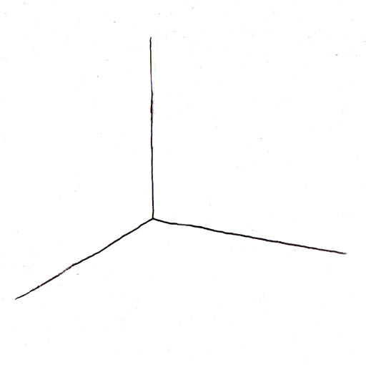
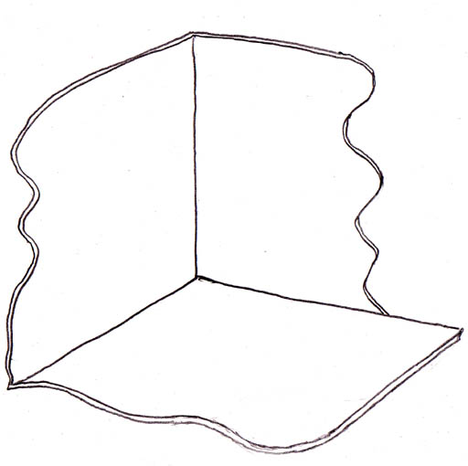
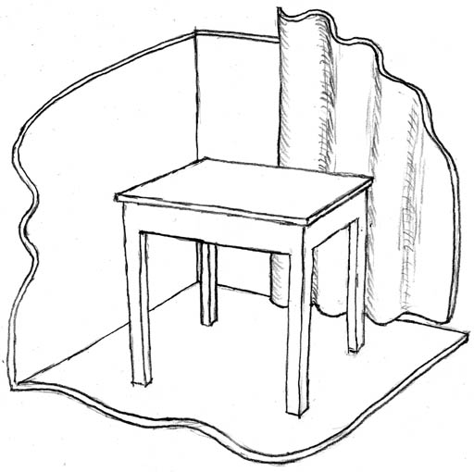
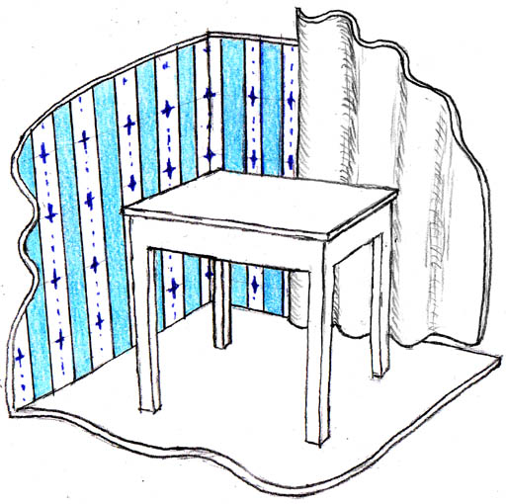
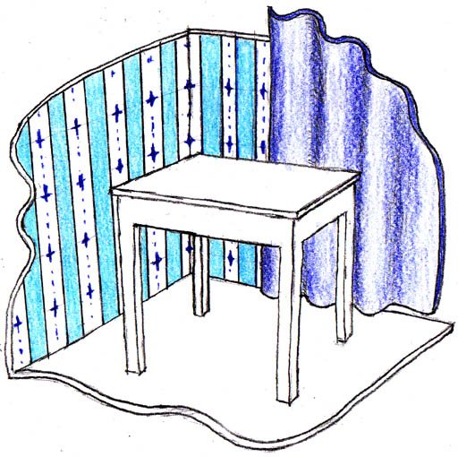
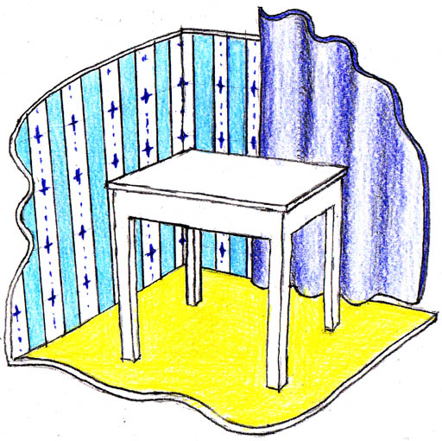
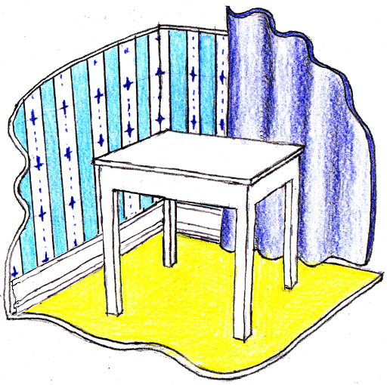
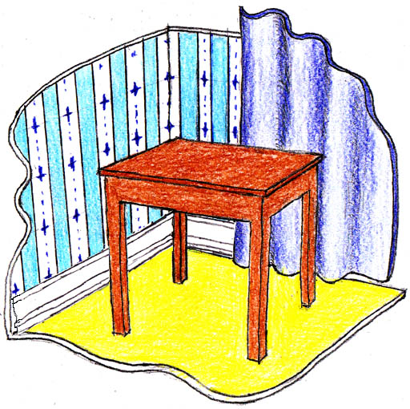
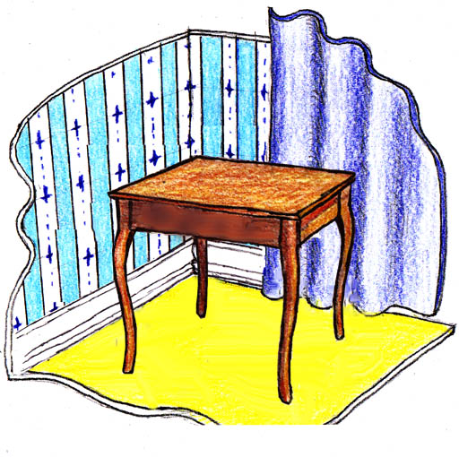

Semantic Network
contains
composed of
corner
wall
wall
floor
baseboard
pattern
table
color
curtain
color
Stripes
yellow
Has a
Vertical
walnut
blue
cabriole
drawer
style
white
With a
shape
ornamental
pattern
blue
wavy
Brass
handle

Slide 39
The semantic network is an abstraction
contains
composed of
corner
Not to be confused with the reified image
wall
wall
floor
baseboard
pattern
table
color
curtain
color
Stripes
yellow
Has a
Vertical
walnut
blue
cabriole
drawer
style
white
With a
shape
ornamental
pattern
blue
wavy
Brass
handle

Slide 40
Some kind of abstraction occurs in cognition
contains
composed of
corner
wall
wall
floor
baseboard
pattern
table
color
curtain
color
Stripes
yellow
Has a
Vertical
walnut
blue
cabriole
drawer
style
white
With a
shape
ornamental
pattern
blue
wavy
Brass
handle

Slide 41
contains
composed of
corner
But spatial experience is not that abstraction
wall
wall
floor
baseboard
pattern
table
color
curtain
color
Stripes
yellow
Has a
Vertical
walnut
blue
cabriole
drawer
style
white
With a
shape
ornamental
pattern
blue
wavy
Brass
handle

Slide 42
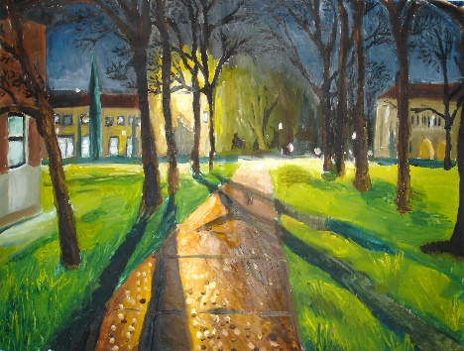

Abstraction
Abstraction
Abstraction
corner
contains
composed of
baseboard
wall
wall
floor
Abstraction
color
pattern
color
table
curtain
Stripes
yellow
walnut
Has a
Vertical
blue
style
cabriole
drawer
white
shape
With a
ornamental
pattern
wavy
blue
Brass
handle
The principle of abstraction is well known

Slide 43
Reification
Reification
Reification
corner
contains
composed of
baseboard
wall
wall
floor
Reification
color
pattern
color
table
curtain
Stripes
yellow
walnut
Has a
Vertical
blue
style
cabriole
drawer
white
shape
With a
ornamental
pattern
wavy
blue
Brass
handle
The inverse principle of reification
most under-acknowledged perceptual principle

Slide 44

Evidence for Reification
In Gestalt Illusions

Slide 45
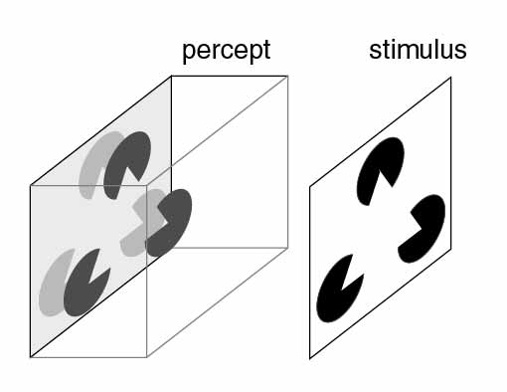
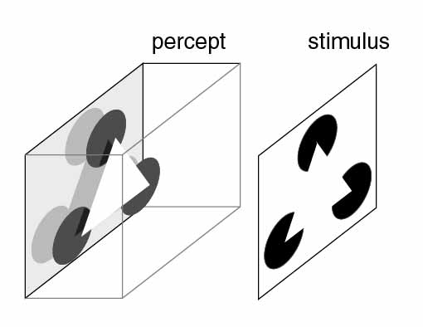

Slide 47

Tse’s Volumetric Worm

Slide 48
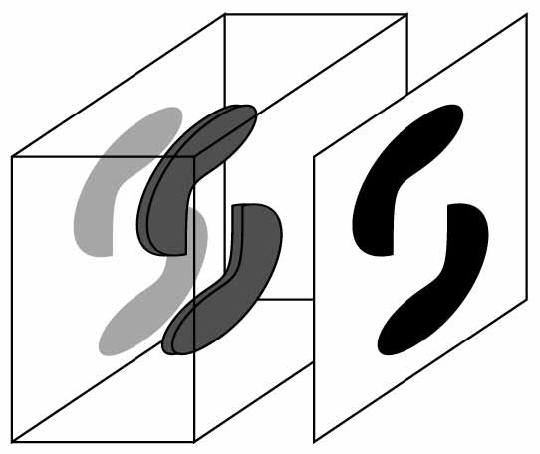

Slide 49
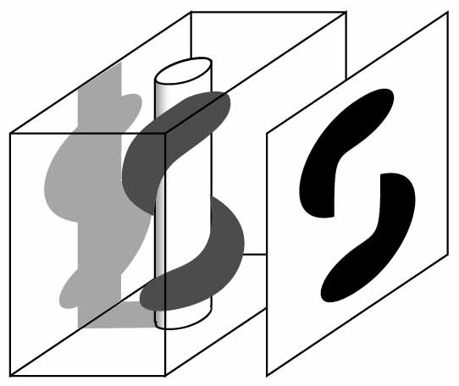

Slide 50

Tse’s Sea Monster

Slide 51
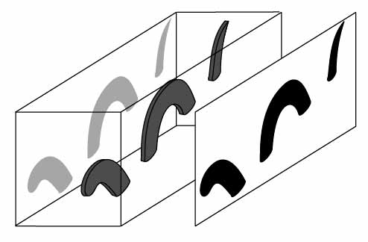

Slide 52
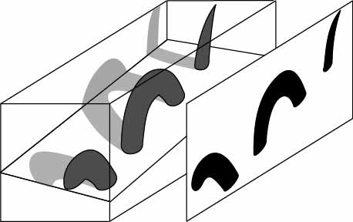

Slide 53
Reification
How
remains a mystery
That it does so is an observational fact

Slide 54

Another observational fact:
Phenomenal Projection

Slide 55







Slide 56




Slide 57

Another observational fact:
Phenomenal Perspective

Slide 58

Phenomenal Perspective

Slide 59
Phenomenal Perspective
Do things in the distance appear smaller?
Or do they appear undiminished in size?

Slide 61

Phenomenal Perspective
Both!
Things in distance smaller and undiminished!
Experience has a Variable representational scale
Distance in the representation
Scale of a representation =
Objective distance it represents

Slide 62

Hallway Experiment
}
A: Euclidean model
B: 3-D Perspective
C: 2-D Perspective projection
Subjects Chose

Slide 63

Hallway Experiment
This model embodies the duality of size perception
Subjects use a warped grid to measure objective size

Slide 64

Ames Room

Slide 65

The Geometry of Visual Experience

Slide 66

The Geometry of Visual Experience

Slide 67

The Geometry of Visual Experience

Slide 68

The Geometry of Visual Experience

Slide 69

The Geometry of Visual Experience
The space of our experience is curved
What does it mean for a space to be curved?
Paradoxical concept?

Slide 70

The Geometry of Visual Experience
Encodes an infinite space in a finite representation

Slide 71



The Epistemological Divide
Direct Perception ?

Slide 72
The Epistemological Divide
Projection Theory ?

Slide 73
The Epistemological Divide
Representationalism

Slide 74


Slide 75


A Cartoon Epistemology
http://cns-alumni.bu.edu/~slehar/cartoonepist/cartoonepist.html
Part I: Something Very Strange!
Part II: There’s nothing strange at all!
Part III: Its all in your head!
Discussion

Slide 76


My book
My paper
2003 Lawrence Erlbaum Assoc.
Behavioral & Brain Sciences (2003) 26(4), 375-444
Steven Lehar
slehar@cns.bu.edu
http://cns-alumni.bu.edu/~slehar/

Slide 77
The End

